Slide 1
Introduction to Machine learning theory

Slide 2
Why learning
Machine learning is programming computers to optimize a performance criterion using example data or past experience
Learning general models from a data of particular examples
Build a model that is a good and useful approximation to the data.
Data is cheap and abundant (data warehouses, data marts); knowledge is expensive and scarce.

Slide 3
When learning
Machine learning is suitable for problems where:
A pattern exists
We can not pin it down mathematically
We have data on it
Learning is used when:
Human expertise does not exist (navigating on Mars)
Humans are unable to explain their expertise (speech recognition)
Solution changes in time (routing on a computer network)

Slide 4
Why learning
If you don't know how to solve a problem, write it out as an optimization problem

Slide 5
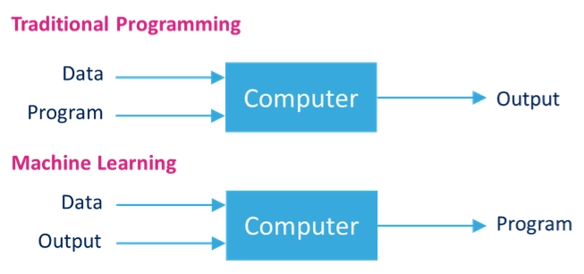
Learning vs Programming
Learning algorithm is implemented as a program

Slide 6
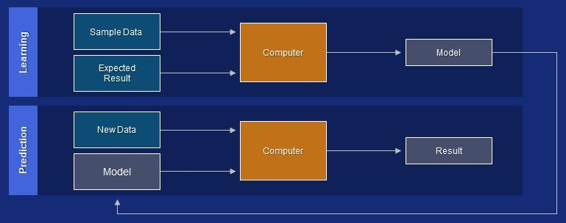
Learning vs Programming
The Learning algorithm and data are implemented as a program

Slide 7



Classification
Text Categorization
Patient data
Yes
Is sick?
No
Medical Diagnosis
Spam detection
Classification assigns data items to target categories or classes

Slide 8
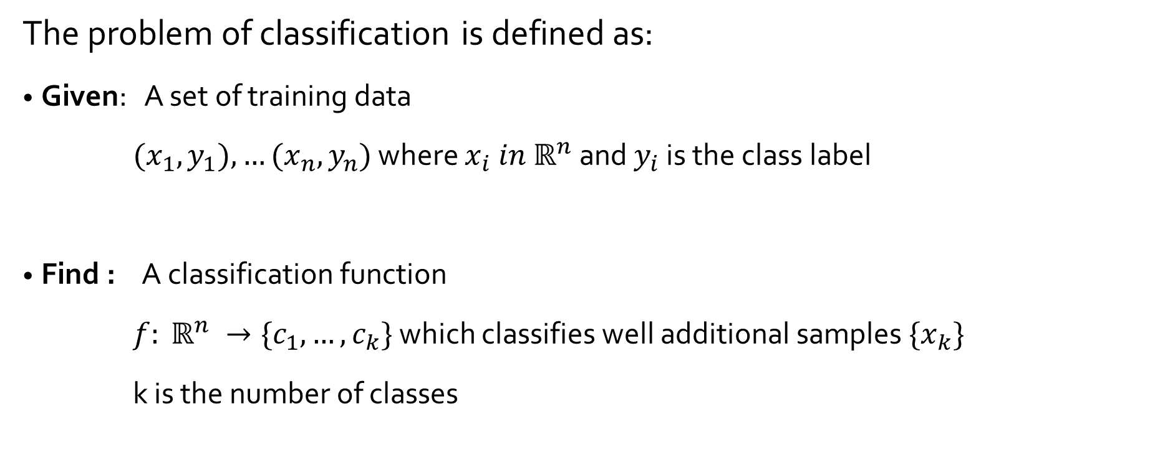
Classification

Slide 9
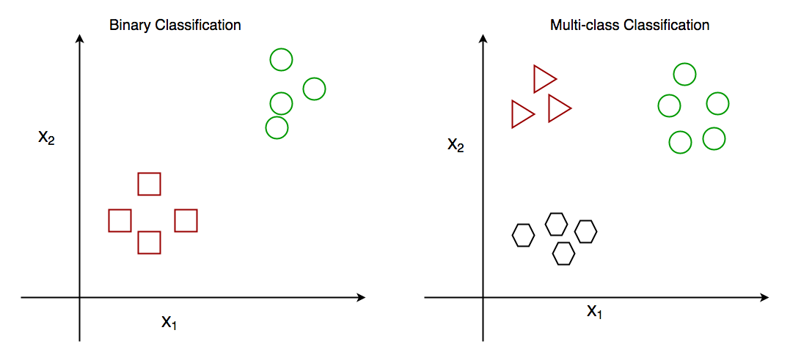
Classification
Binary vs multiclass classification
2 target classes
Samples belong to one of the two classes
n target classes
Samples belong to one of the n classes

Slide 10
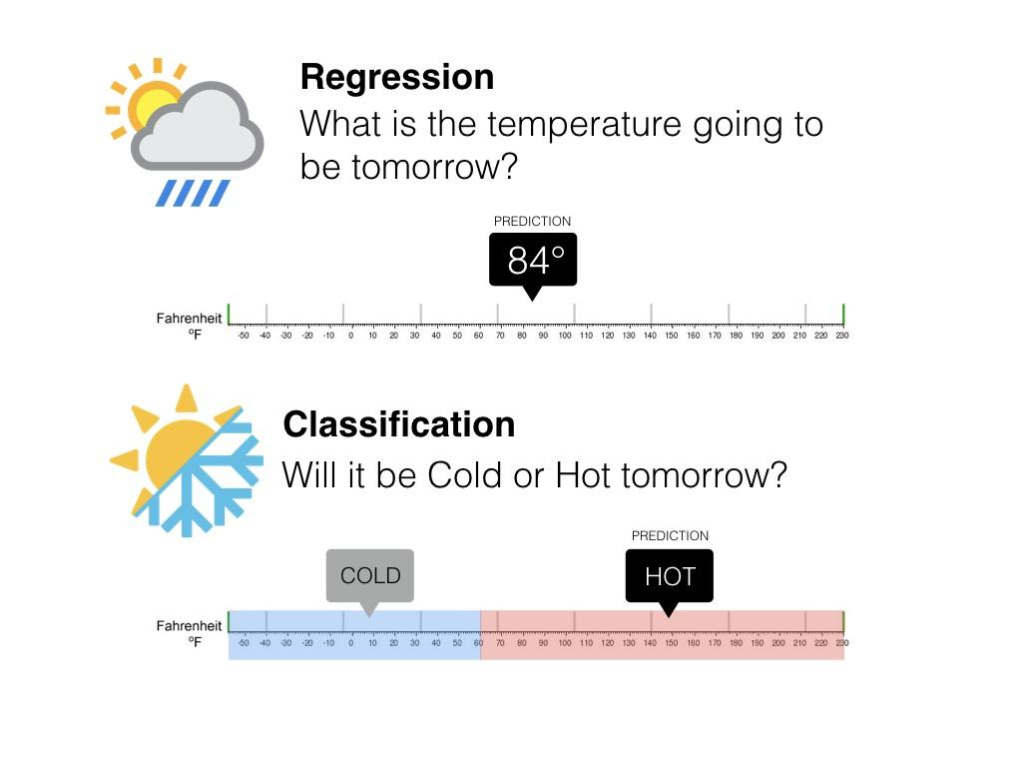
Classification vs regression
Regression is the task of predicting a continuous quantity
Classification is the task of predicting a discrete class label
But, generally models return numbers (probability, ….)

Slide 11
ML: Classification methods
Approaches to learn classifiers/predictors: learning algorithms
Linear classifiers: linear Regression, Bayesian classifier
Support Vector Machines (SVM)
Decision trees
Random Forest
K-Nearest Neighbor
Neural Networks
…
What the matter between the different machine learning algorithms?

Slide 12

ML: Classification methods
Approaches to learn classifiers/predictors:
Linear classifiers: linear Regression, Bayesian classifier
Support Vector Machines (SVM)
Decision trees
Random Forest
K-Nearest Neighbor
Neural Networks
…
What the matter between the different machine learning algorithms?

Slide 13
ML: Main components
Model representation (hypothesis space):
Structure of the functional form of the knowledge to be extracted (Trees, partition, graph,…)
Search method (learning algorithm):
Strategy used to explore the search space and find the optimal or “good” model (backpropagation, local search, divide-and-conquer, greedy search, …)
Objectif function (cost function):
Measure the quality of the model (Gini, Entropy, RMSE, logloss, …)

Slide 14
Reviewing the learning models

Slide 15
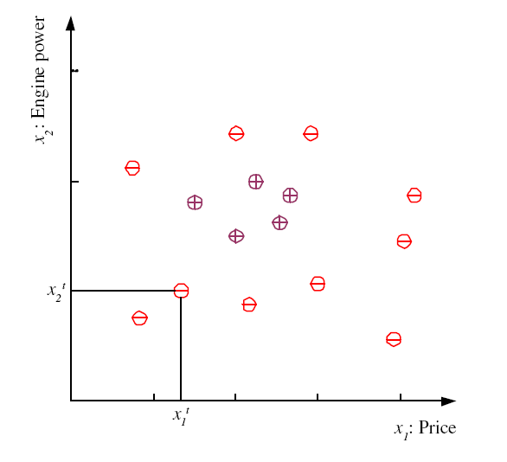
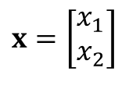
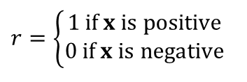
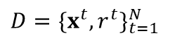
Hypothesis space (class) H
Let start with a sample problem of binary classification
Prediction of “family car”
Prediction: Is car x a family car?
Knowledge extraction:
What do people expect from a family car?
Output:
Positive (+) and negative (–) examples
Input representation:
x1: price, x2 : engine power
$$D=\{x^{t},r^{t}\}_{t=1}^{N}$$
$$r=\left\{\begin{matrix}1 \text{if} x \text{is} \text{positive} \\ 0 \text{if} x \text{is} \text{negative}\end{matrix}\right.$$
$$x=\left[\begin{matrix}x_{1} \\ x_{2}\end{matrix}\right]$$

Slide 16
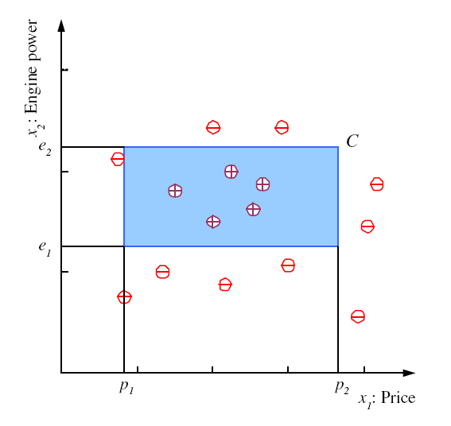
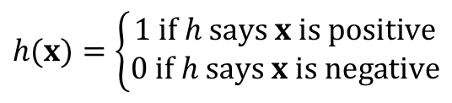
Hypothesis space H
Rectangle learning:
Hypothesis is any axis aligned Rectangle. Inside rectangle is positive
H is the set of all possible rectangle called the hypothesis space
$$\left(p_{1}≤ \text{price} ≤ p_{2}\right) \text{AND} \left(e_{1}≤ \text{engine} \text{power} ≤ e_{2}\right)$$
$$h(x)=\left\{\begin{matrix}1 \text{if} h \text{says} x \text{is} \text{positive} \\ 0 \text{if} h \text{says} x \text{is} \text{negative}\end{matrix}\right.$$

Slide 17
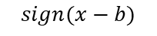
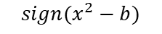
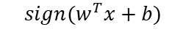
Hypothesis space (class) H
$$sign(w^{T}x+b)$$
b
$$sign(x−b)$$
$$sign(x^{2}−b)$$

Slide 18
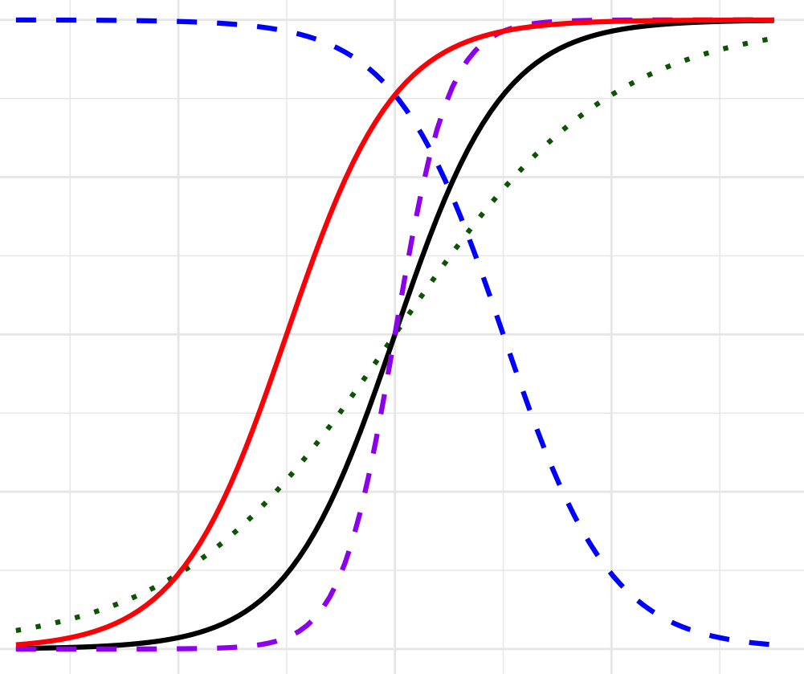

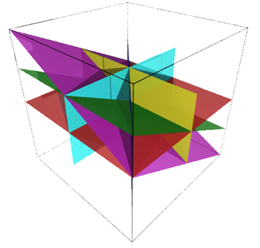
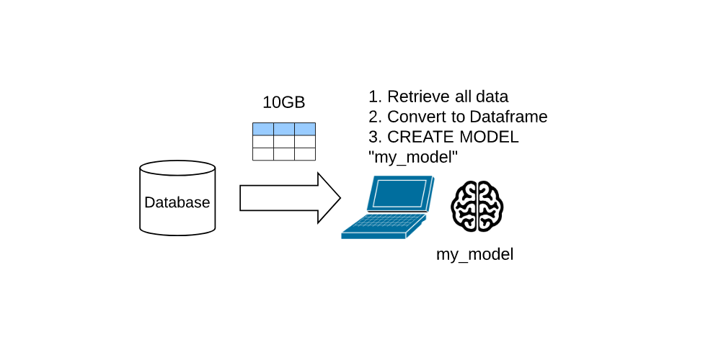

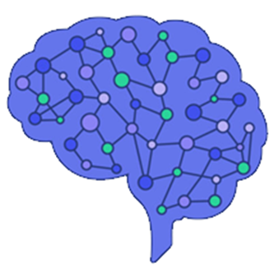
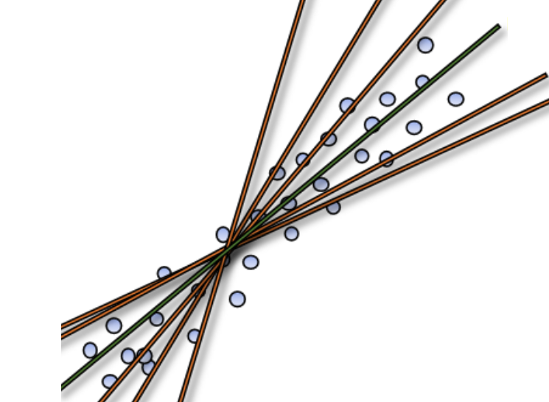
Hypothesis space H
logistic
Which hypothesis space ?
Trees and Forests
Hyperplans
linear
Neural networks

Slide 19
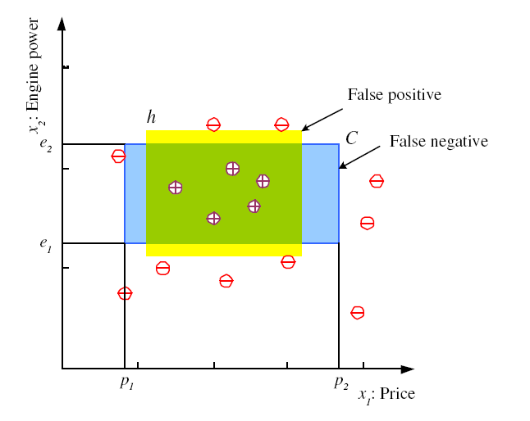
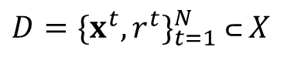
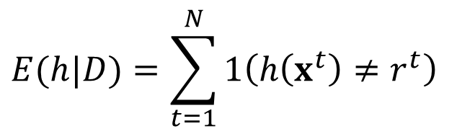
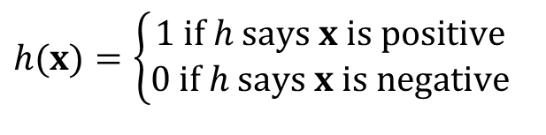
Hypothesis space H
Rectangle learning:
Assume that h is given: what is the Error of h on H?
$$D=\{x^{t},r^{t}\}_{t=1}^{N} \text{⊂} X$$
$$h(x)=\left\{\begin{matrix}1 \text{if} h \text{says} x \text{is} \text{positive} \\ 0 \text{if} h \text{says} x \text{is} \text{negative}\end{matrix}\right.$$
$$E(h|D)=\sum_{t=1}^{N}{1\left(h\left(x^{t}\right)≠r^{t}\right)}$$

Slide 20
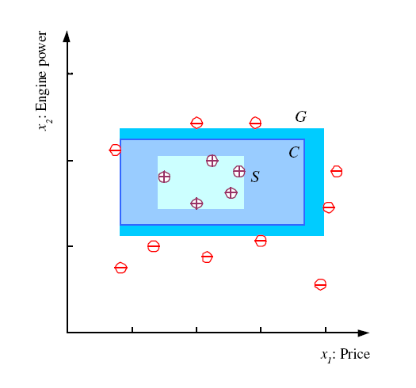
Hypothesis space H
Rectangle learning:
The version space (VS) with the respect to a hypothesis space H and the training set D is the subset of hypothesis from H consistant with the training set D
most specific hypothesis, S
most general hypothesis G
h ∈ H, between S and G is
Consistent (𝐸(ℎ|D)= 0)and make up the version space (Mitchell, 1997)

Slide 21
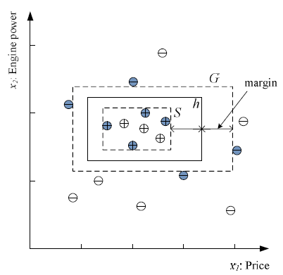
Hypothesis space H
Rectangle learning:
To generalize better, choose h with largest margin

Slide 22
Hypothesis space H
Rectangle learning:
But for a given dataset X, how to compute h? Learning algorithm (or learner)

Slide 23
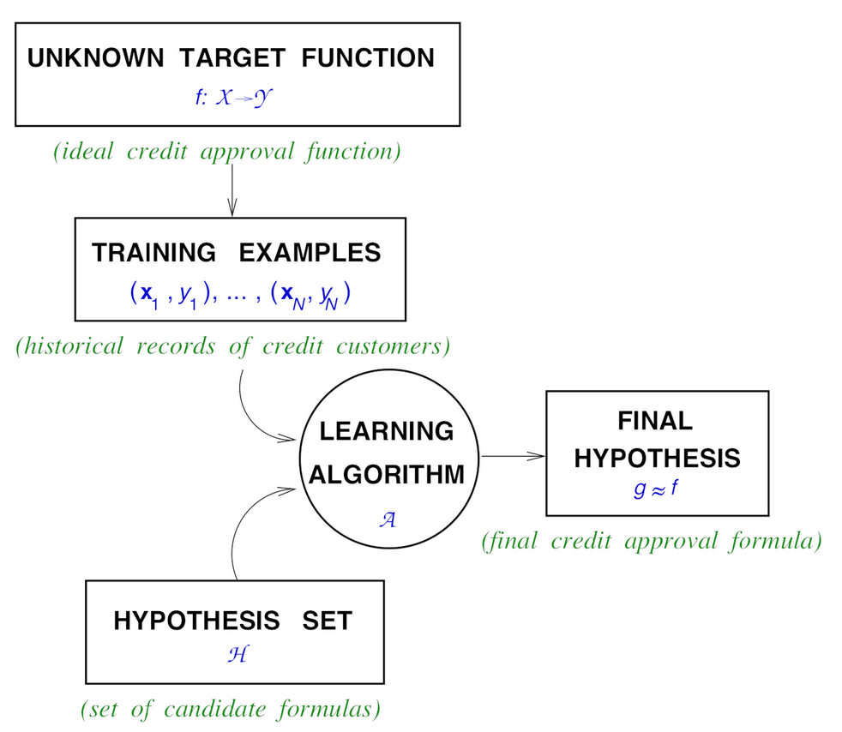
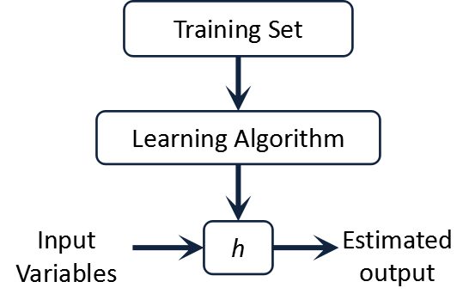
Hypothesis space H
Each hypothesis space has it learning algorithm
The hypothesis set and learning algorithm together, is called a Learning Model

Slide 24
Hypothesis space H
The hypothesis set and learning algorithm together, is called a Learning Model
Question 1: what is the best learning model?
Question2: how good is a learning model, given dataset ?
Question 3: what is the capacity (complexity, expressive power, richness, or flexibility) of a learning model ?

Slide 25
Q1: No Free Launch (NFL) theorem
In his 1996 paper, “The Lack of A Priori Distinctions Between Learning Algorithms”, Wolpert introduced the NFL theorem for supervised machine learning.
“ The theorem states that given a noise-free dataset, for any two machine learning algorithms A and B (learning model), the average performance of A and B will be the same across all possible problem instances drawn from a uniform probability distribution”

Slide 26
Q1: No Free Launch (NFL) theorem
Does it mean that all algorithms are equal? No, of course not.
Some algorithms may generally perform better than others on certain types of problems, but every algorithm has disadvantages and advantages due to the prior assumptions that come with that algorithm.
XGBoost may win hundreds of Kaggle competitions yet fail miserably at forecasting tasks because of the limiting assumptions involved in tree-based models.
Neural networks may perform really well when it comes to complex tasks like image classification and speech detection, yet suffer from overfitting due to their complexity if not trained properly.

Slide 27
Q1: No Free Launch (NFL) theorem
In practice, this is what “no free lunch” means for you:
No single algorithm will solve all your machine learning problems better than every other algorithm.
Make sure you completely understand a machine learning problem and the data involved before selecting an algorithm to use.
All models are only as good as the assumptions that they were created with and the data that was used to train them.
Simpler models like logistic regression have more bias and tend to underfit, while more complex models like neural networks have more variance and tend to overfit.
The best models for a given problem are somewhere in the middle of the two bias-variance extremes.
To find a good model for a problem, you may have to try different models and compare them using a robust cross-validation strategy.

Slide 28
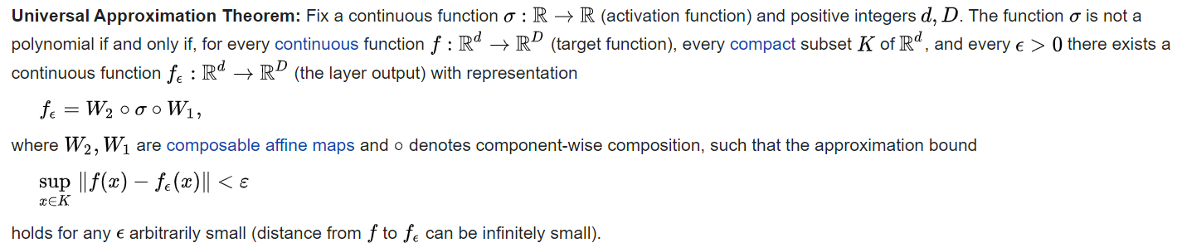
Q1: Universal Approximation Theorem.
A feedforward network with a single layer is sufficient to represent any function, but the layer may be infeasibly large and may fail to learn and generalize correctly.

Slide 29
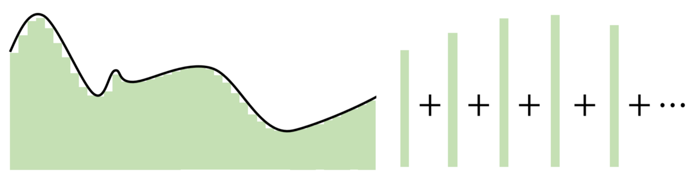
Q1: Universal Approximation Theorem.
The key point in the Universal Approximation Theorem is that instead of creating complex mathematical relationships between the input and output, it uses simple linear manipulations to divvy up the complicated function into many small, less complicated pieces, each of which are taken by one neuron.

Slide 30
Q1: Universal Approximation Theorem.
The number of hidden neurons should be between the size of the input layer and the output layer.
The most appropriate number of hidden neurons is sqrt(input layer nodes * output layer nodes)

Slide 31
Q1: Universal Approximation Theorem.
A model with too little capacity cannot learn the problem, whereas a model with too much capacity can learn it too well and overfit the training dataset. Both cases result in a model that does not generalize well.
The capacity of a neural network model is defined by both it’s structure in terms of nodes and layers and the parameters in terms of its weights. Therefore, we can reduce the complexity of a neural network to reduce overfitting in one of two ways:
Change network complexity by changing the network structure (number of weights): grid search until a suitable number of nodes and/or layers
Change network complexity by changing the network parameters (values of weights): keeping network weights small

Slide 32
Hypothesis space H
The hypothesis set and learning algorithm together, is called a Learning Model
Question 1: what is the best learning model?
Question 2: how good is a learning model, given a dataset ?
Question 3: what is the capacity (complexity, expressive power, richness, or flexibility) of a learning model ?

Slide 33
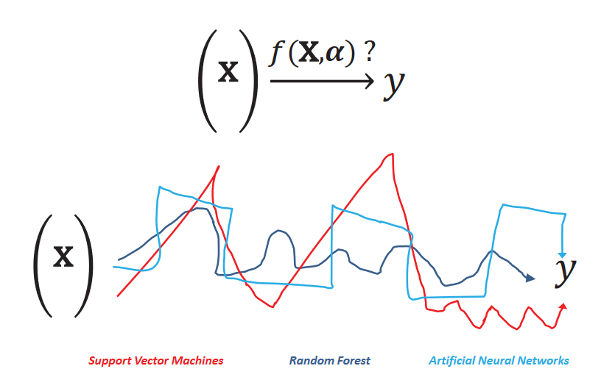
ML: Learners
Which learning algorithms? Approaches to learn classifiers/predictors

Slide 34
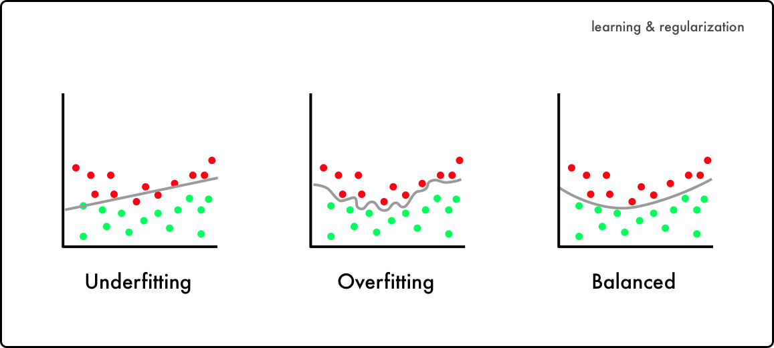
ML: Objective function
At the end of the day, the learning algorithm in a given hypothesis space will give me a candidate model
If you look too hard at a dataset, you will find something, but it might not generalize beyond the data you're looking at (unseen data) = Overfitting
But
HOW GOOD IS YOUR MODEL

Slide 35
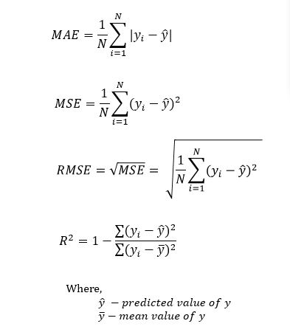
ML: Objective function
Cost function quantifies the error between predicted values and expected values and presents it in the form of a single real number.
We have various measures of model error (any norm) depending on the hypothesis space
Mean Absolute Error (MAE)
Mean Square Error (MSE)
Root Mean Square Error (RMSE)

Slide 36
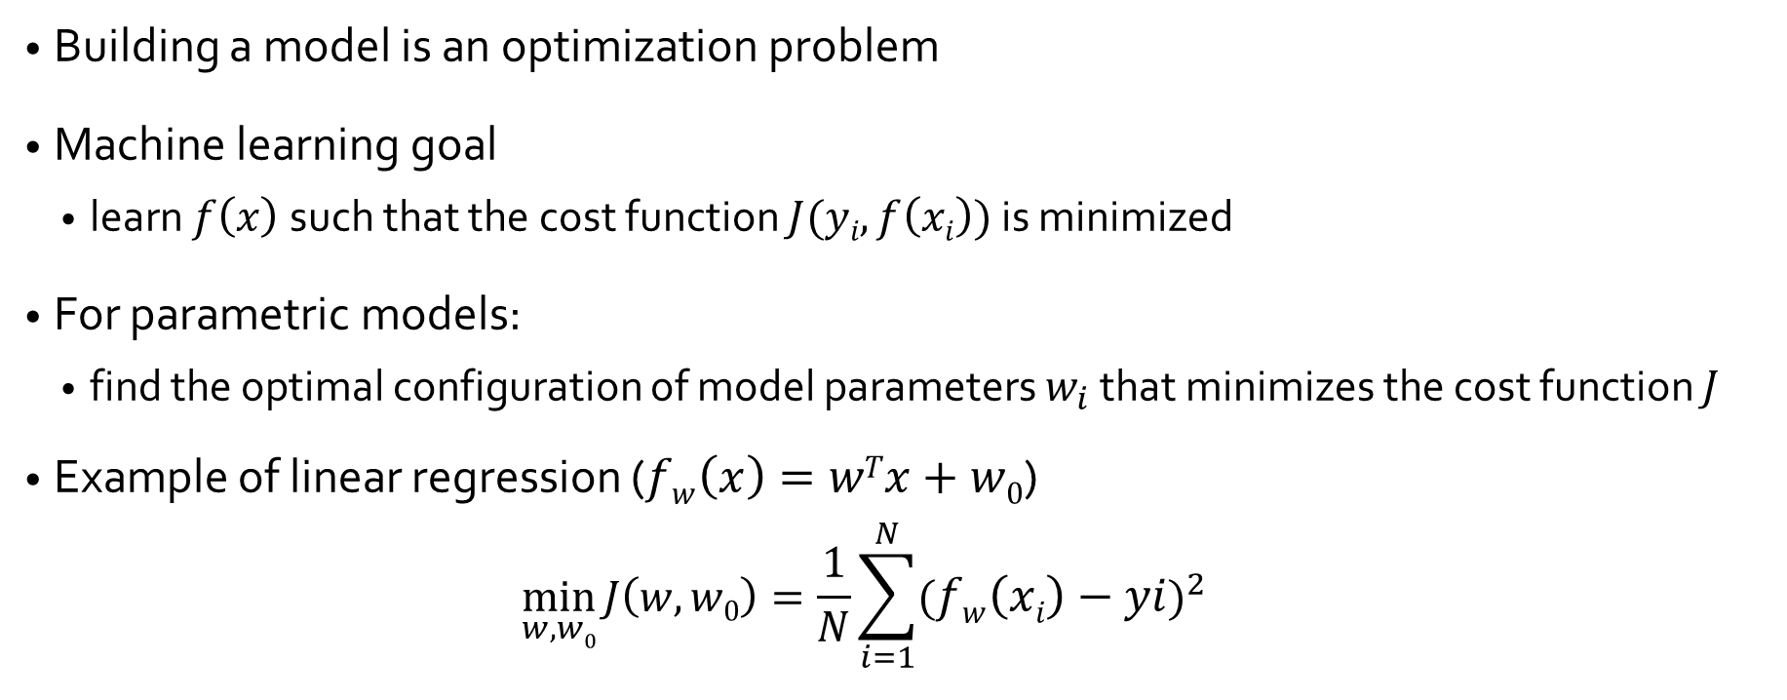
ML: Objective function

Slide 37
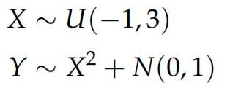
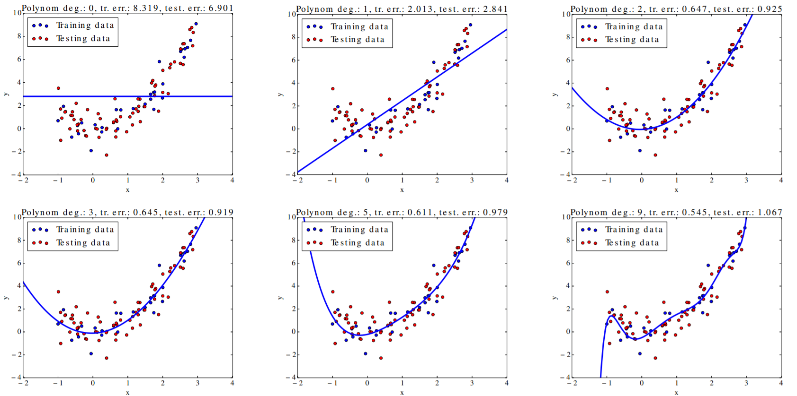
Training and testing error
Example: Polynomial regression with varying degree

Slide 38
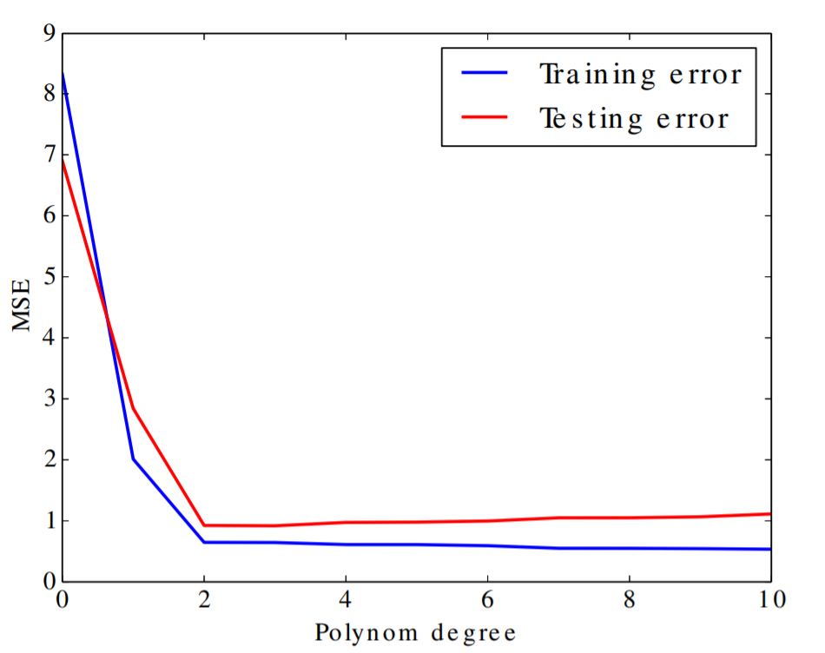
Training and testing error
The training error decreases with increasing model flexibility (the curviness).
The testing error is minimal for certain degree of model flexibility.

Slide 39
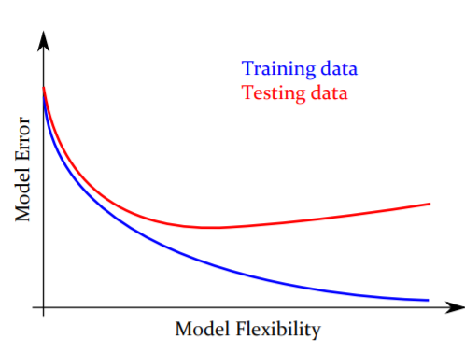
Overfitting
Overfitting is a general phenomenon affecting all kinds of inductive learning.
When overfitted, the model works well for the training data, but fails for new (testing) data.

Slide 40
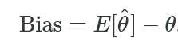
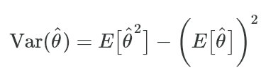
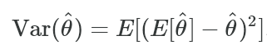
Bias vs Variance
The bias error is an error from erroneous assumptions in the learning algorithm. High bias can cause an algorithm to miss the relevant relations between features and target outputs (underfitting).
The variance is an error from sensitivity to small fluctuations in the training set. High variance may result from an algorithm modeling the random noise in the training data (overfitting).

Slide 41
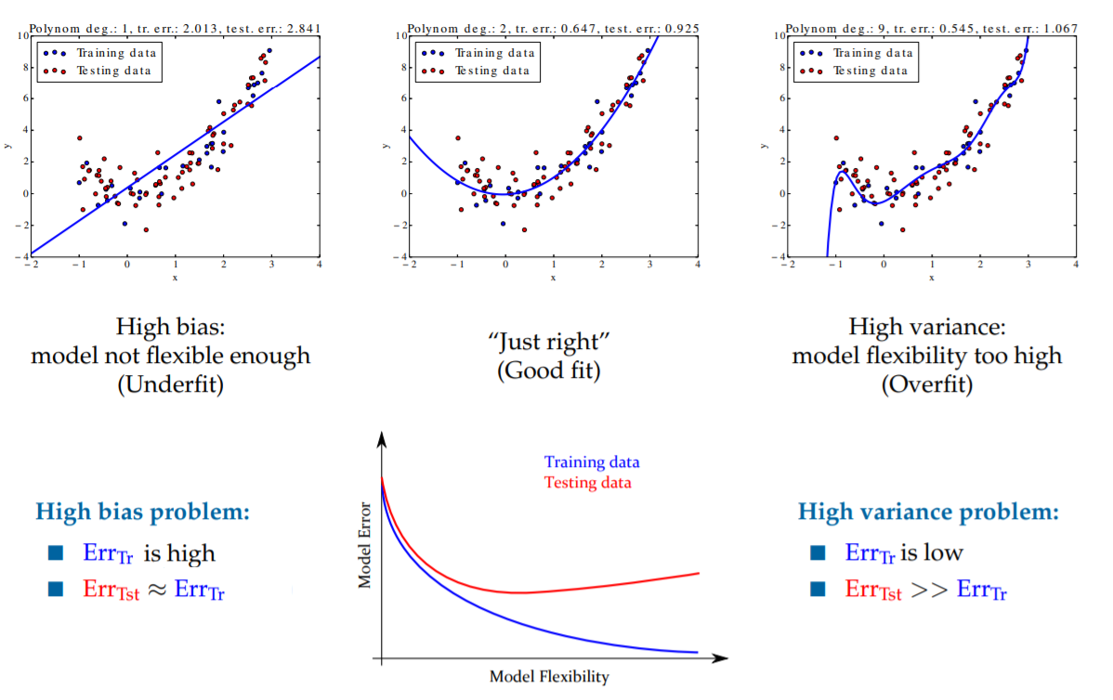
Bias vs Variance

Slide 42
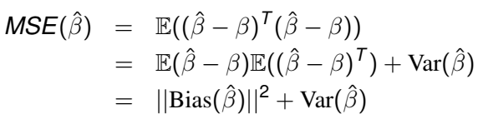
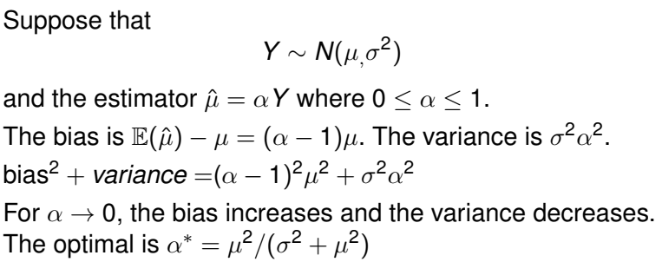
Bias – Variance Tradeoff
Simple example

Slide 43

Regularization
Who to deal with overfitting ?

Slide 44
Regularization
Reduce the model complexity
Reduce the width of the tree, size, …
Reduce the number of parameters (number of neurons, layers, …)
Reduce the values of parameters (small values, zeros, …)
In parameterized model, a regularization technique is a penalty mechanism which applies shrinkage (driving them closer to zero) of coefficient to build a more robust and parsimonious model.
Reduce model variance at the cost of introducing some bias.
Notes:
Parsimonious = tight

Slide 45
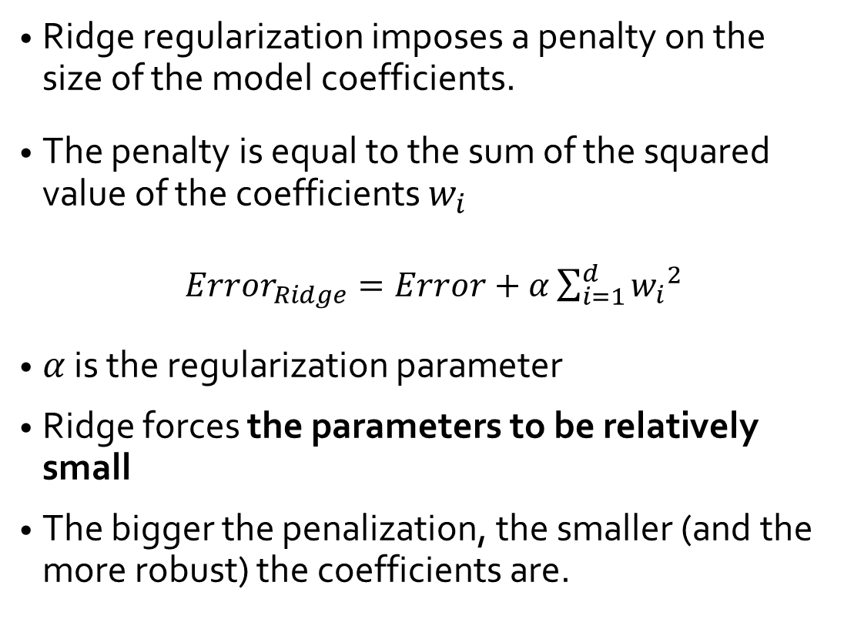
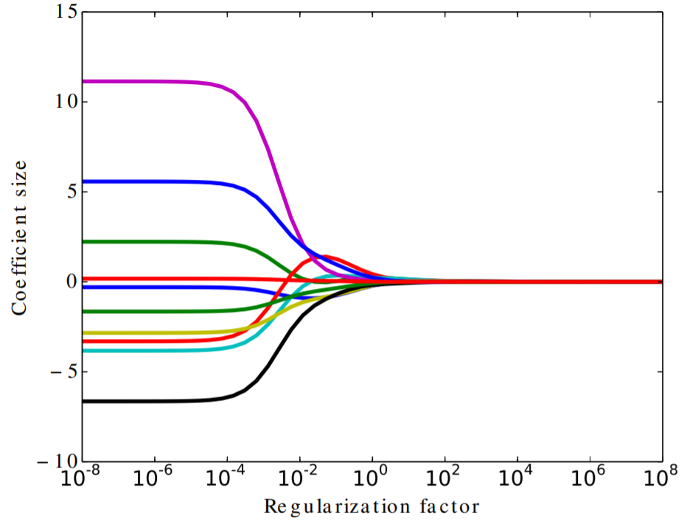
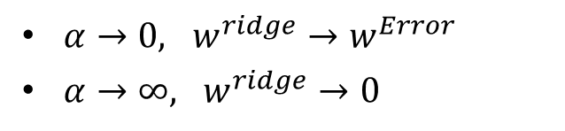
Ridge regularization (L2 regularization)

Slide 46
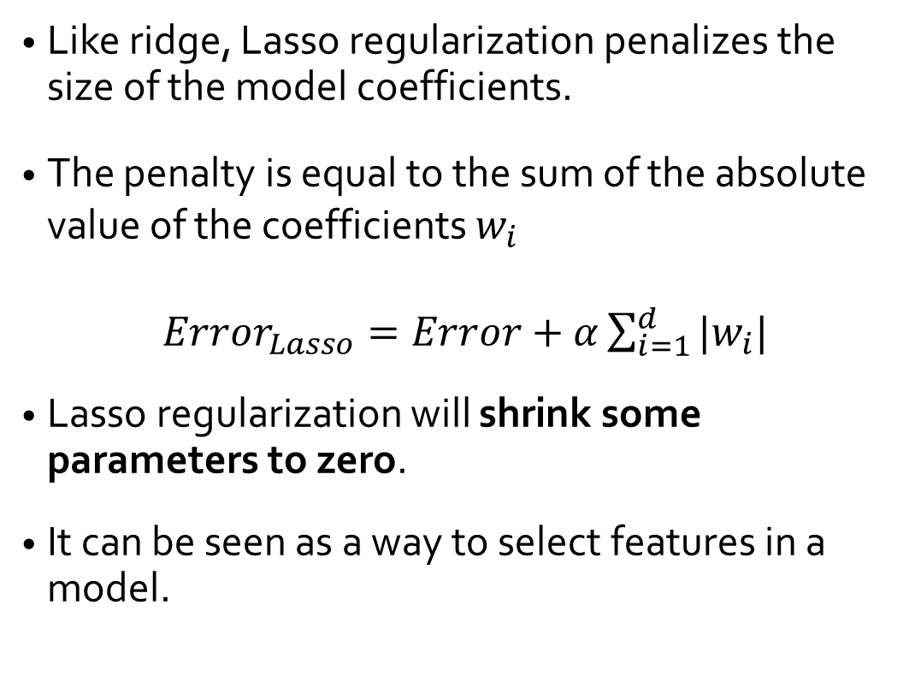
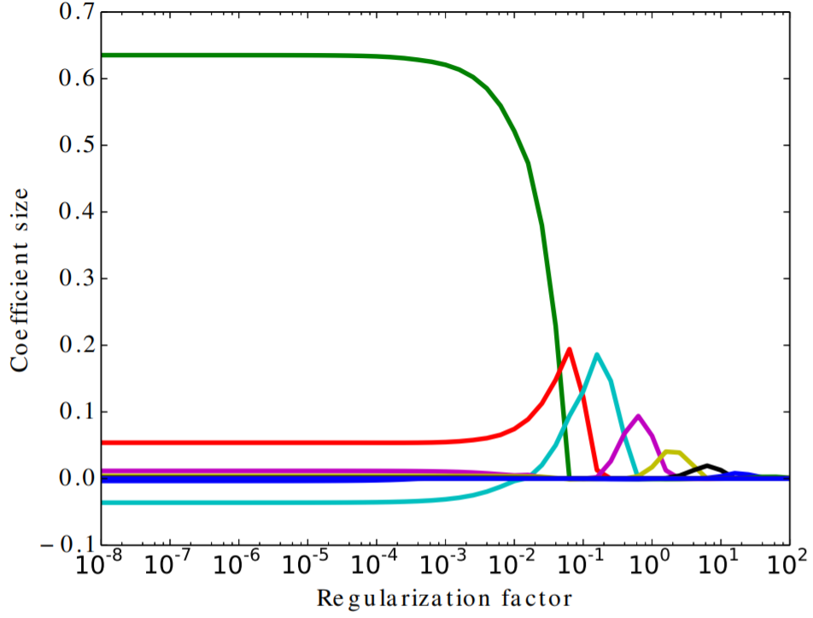
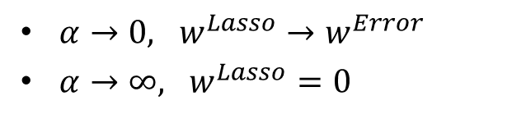
Lasso regularization (L1 regularization)

Slide 47
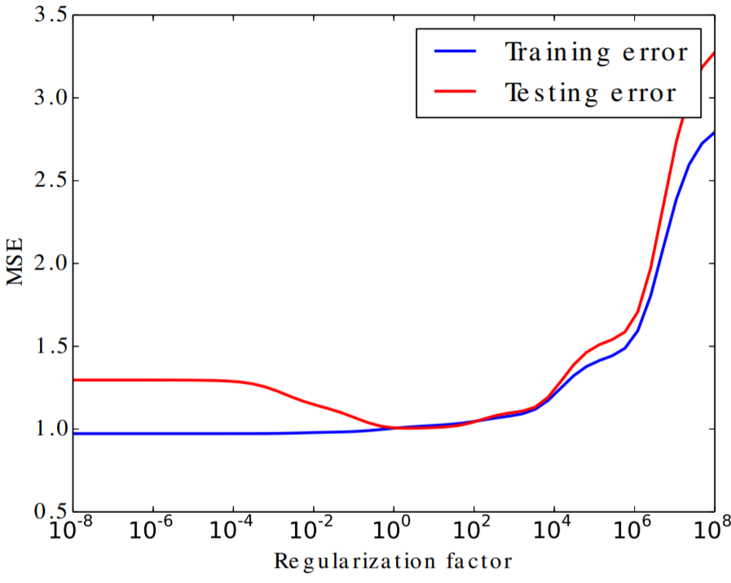

Ridge vs Lasso
Evolution of error vs regularization factor
Ridge (L2 regularization)
Lasso (L1 regularization)
Notes:
https://www4.stat.ncsu.edu/~lu/ST7901/lecture%20notes/2019Lect7_shrink_lassoBeyond.pdf

Slide 48
When the LASSO fails?
In the d > n case, the lasso can select at most n variables before it saturates (d: number of paramters and n: number of samples)
If there is a group of variables with very high pairwise correlations, the lasso tends to select only one variable from the group, not caring which one
For usual n > d situations, if there are high correlations between variables, the prediction performance of lasso is poor with respect to ridge.
Notes:
https://www4.stat.ncsu.edu/~lu/ST7901/lecture%20notes/2019Lect7_shrink_lassoBeyond.pdf

Slide 49

Elastic-net
Notes:
½ : maybe any value

Slide 50

Bias-Variance Tradeoff
To get good predictions, we need to find a balance of Bias and Variance that minimizes total error
Notes:
he irreducible error is the error that we can not remove with our model, or with any model. The error is caused by elements outside our control, such as statistical noise in the observations.
For error decomposition proof: https://robjhyndman.com/files/2-biasvardecomp.pdf

Slide 51
Reviewing some ML models

Slide 52
ML: Tree-based models
Hypothesis space: Tree-based models
Representation = Tree or Forest
Learning algorithm = Greedy algorithms
Split the data based on an attribute that optimizes certain criterion
Examples:
CHAID, CART
ID3, C4.5, SLIQ, SPRINT
The learning algorithms different on the:
The considered attributes
Theirs types
How they are used (one or several time)
The form of the tree/forest
The criteria to optimize
Notes:
https://victorzhou.com/blog/information-gain/
Most of tree are similar they different on the type of attributes: numerical/categorical/discret … the number of noeud (binaire or not)
CART algorithm in decision tree: is a classification algorithm for building a decision tree based on Gini's impurity index as splitting criterion. CART is a binary tree build by splitting node into two child nodes repeatedly.

Slide 53


ML: Tree-based models
The most important criteria in Trees is the notion of impurity
Used to judge the splits and to mesure the order/desorder
Based on attributes and their modalities
Notes:
https://victorzhou.com/blog/information-gain/
Most of tree are similar they different on the type of attributes: numerical/categorical/discret … the number of noeud (binaire or not)
CART algorithm in decision tree: is a classification algorithm for building a decision tree based on Gini's impurity index as splitting criterion. CART is a binary tree build by splitting node into two child nodes repeatedly.

Slide 54






ML: Tree-based models
Gini impurity
If we have C total classes and p(i) is the probability of picking a datapoint with class i, then the Gini Impurity is calculated as: $G= \sum_{i=1}^{C}{p\left(i\right)∗(1−p(i)}$)
Notes:
https://victorzhou.com/blog/information-gain/
Most of tree are similar they different on the type of attributes: numerical/categorical/discret … the number of noeud (binaire or not)
CART algorithm in decision tree: is a classification algorithm for building a decision tree based on Gini's impurity index as splitting criterion. CART is a binary tree build by splitting node into two child nodes repeatedly.

Slide 55





ML: Tree-based models
Gini impurity
If we have C total classes and p(i) is the probability of picking a datapoint with class i, then the Gini Impurity is calculated as: $G= \sum_{i=1}^{C}{p\left(i\right)∗(1−p(i)}$)
The information gain: how much Gini we removed
Since Left Branch has 4 elements and Right Branch has 6, we get (Mean):
Notes:
https://victorzhou.com/blog/information-gain/
Most of tree are similar they different on the type of attributes: numerical/categorical/discret … the number of noeud (binaire or not)
CART algorithm in decision tree: is a classification algorithm for building a decision tree based on Gini's impurity index as splitting criterion. CART is a binary tree build by splitting node into two child nodes repeatedly.

Slide 56

ML: Tree-based models
Entropy impurity
If we have C total classes and p(i) is the probability of picking a datapoint with class i, then the Gini Impurity is calculated as: $E=−\sum_{i=1}^{C}{p\left(i\right)∗log2(p(i)}$)
Maximum Gini or Entropy gain is used as splitting criterion
Notes:
https://victorzhou.com/blog/information-gain/
Most of tree are similar they different on the type of attributes: numerical/categorical/discret … the number of noeud (binaire or not)
CART algorithm in decision tree: is a classification algorithm for building a decision tree based on Gini's impurity index as splitting criterion. CART is a binary tree build by splitting node into two child nodes repeatedly.

Slide 57
ML: Tree-based models
Learning algorithms
Node impurity
Gini, Entropy, Gain, Khi2, …
Bagging = Bootstrap + aggregating
Subsamples (random forest) vs all samples (DT, ET, …)
Attribute selection: (random) greedy heuristics
optimum split (random forest)
randomly split (extra trees)
Nodes with homogenous class distribution are preferred
Boosting (more general)
Bias-variance Tradeoff
Multiple objectives: Misclassification error; Tree size (Prunning), depth, ..
Notes:
https://victorzhou.com/blog/information-gain/
Most of tree are similar they different on the type of attributes: numerical/categorical/discret … the number of noeud (binaire or not)
CART algorithm in decision tree: is a classification algorithm for building a decision tree based on Gini's impurity index as splitting criterion. CART is a binary tree build by splitting node into two child nodes repeatedly.

Slide 58


ML: Tree-based models
Bagging vs Boosting
Notes:
https://victorzhou.com/blog/information-gain/
Most of tree are similar they different on the type of attributes: numerical/categorical/discret … the number of noeud (binaire or not)
CART algorithm in decision tree: is a classification algorithm for building a decision tree based on Gini's impurity index as splitting criterion. CART is a binary tree build by splitting node into two child nodes repeatedly.

Slide 59

ML: Main components
Hypothesis space: Tree-based models
Notes:
https://victorzhou.com/blog/information-gain/
Most of tree are similar they different on the type of attributes: numerical/categorical/discret … the number of noeud (binaire or not)
CART algorithm in decision tree: is a classification algorithm for building a decision tree based on Gini's impurity index as splitting criterion. CART is a binary tree build by splitting node into two child nodes repeatedly.

Slide 60
ML: Hyperplane models
Hypothesis space: SVM models
Representation = Hyperplane
Learning algorithm = quadratic optimization algorithm with linear constraints
A method used for regression and classification (mostly used in classification problems)
SVM is fundamentally a binary classifier, but can be extended for multiclass problems
Classification performed by learning a linear separator of the data
Notes:
https://victorzhou.com/blog/information-gain/
Most of tree are similar they different on the type of attributes: numerical/categorical/discret … the number of noeud (binaire or not)
CART algorithm in decision tree: is a classification algorithm for building a decision tree based on Gini's impurity index as splitting criterion. CART is a binary tree build by splitting node into two child nodes repeatedly.

Slide 61


ML: SVM models
Linear SVM
There exists an infinite number of linear separators which one is optimal?
Larger margin is preferred for generalization
margin
Notes:
https://victorzhou.com/blog/information-gain/
Most of tree are similar they different on the type of attributes: numerical/categorical/discret … the number of noeud (binaire or not)
CART algorithm in decision tree: is a classification algorithm for building a decision tree based on Gini's impurity index as splitting criterion. CART is a binary tree build by splitting node into two child nodes repeatedly.

Slide 62


ML: SVM models
Non-Linear SVM
Kernel methods: sigmoid, polynomial, …
More difficult problem, we use metaheuristics
Notes:
https://victorzhou.com/blog/information-gain/
Most of tree are similar they different on the type of attributes: numerical/categorical/discret … the number of noeud (binaire or not)
CART algorithm in decision tree: is a classification algorithm for building a decision tree based on Gini's impurity index as splitting criterion. CART is a binary tree build by splitting node into two child nodes repeatedly.

Slide 63
ML: Neural Network models
Hypothesis space: NN models
NN = Direct graph
Objective function: classification error
Learning algorithm = optimization algorithm (backpropagation using gradient, …)
NP-Hard and complex problem
Metaheuristics have been widely used
Notes:
https://towardsdatascience.com/optimizers-for-training-neural-network-59450d71caf6
https://www.analyticsvidhya.com/blog/2021/10/a-comprehensive-guide-on-deep-learning-optimizers/

Slide 64


ML: Neural Network models
Synapse
Dendrites
Activation
Neuron will fire or not
Axon
Body cell (soma)

Slide 65

ML: Neural Network models
Forward propagation: the weights are fixed and the input signal is propagated through the network layers, until it reaches the output.
Error is estimated by comparing the network output and the desired response.
Backward propagation: the error is propagated through the network layers in the backward direction
Notes:
https://victorzhou.com/blog/information-gain/
Most of tree are similar they different on the type of attributes: numerical/categorical/discret … the number of noeud (binaire or not)
CART algorithm in decision tree: is a classification algorithm for building a decision tree based on Gini's impurity index as splitting criterion. CART is a binary tree build by splitting node into two child nodes repeatedly.

Slide 66



ML: Neural Network models
Forward
Several architectures: FFNN, CNN, RNN
Backpropagation
Several optimizer to deal with vanishing and exploding gradient:
Gradient Descent (GD), Stochastic GD, mini-batch GD, Momentum, Adam, AdaGrad, RMSPROP,
Notes:
https://www.analyticsvidhya.com/blog/2021/10/a-comprehensive-guide-on-deep-learning-optimizers/

Slide 67
ML: Neural Network models
Overfitting
You should always consider using regularization, unless you have a very large dataset,
Reduce overfitting by training the network on more examples.
Reduce overfitting by changing the complexity of the network.
Change network complexity by changing the network structure (number of weights).
Change network complexity by changing the network parameters (values of weights)
Notes:
https://www.analyticsvidhya.com/blog/2021/10/a-comprehensive-guide-on-deep-learning-optimizers/

Slide 68
ML: Neural Network models
Regularization Methods for Neural Networks
Weight Regularization (weight decay): Penalize the model during training based on the magnitude of the weights.
Activity Regularization: Penalize the model during training base on the magnitude of the activations.
Weight Constraint: Constrain the magnitude of weights to be within a range or below a limit.
Dropout: Probabilistically remove inputs during training.
Noise: Add statistical noise to inputs during training.
Early Stopping: Monitor model performance on a validation set and stop training when performance degrades.
Notes:
https://www.analyticsvidhya.com/blog/2021/10/a-comprehensive-guide-on-deep-learning-optimizers/

Slide 69
ML: Neural Network models
Some more specific recommendations for Multilayer Perceptrons and Convolutional Neural Networks.
Classical: use early stopping and weight decay (L2 weight regularization).
Alternate: use early stopping and added noise with a weight constraint.
Modern: use early stopping and dropout, in addition to a weight constraint.
Some more specific recommendations for recurrent neural nets
Classical: use early stopping with added weight noise and a weight constraint such as maximum norm.
Modern: use early stopping with a backpropagation-through-time-aware version of dropout and a weight constraint.
Notes:
https://www.analyticsvidhya.com/blog/2021/10/a-comprehensive-guide-on-deep-learning-optimizers/

Slide 70

ML: Main components
Hypothesis space: NN models

